Slide 1
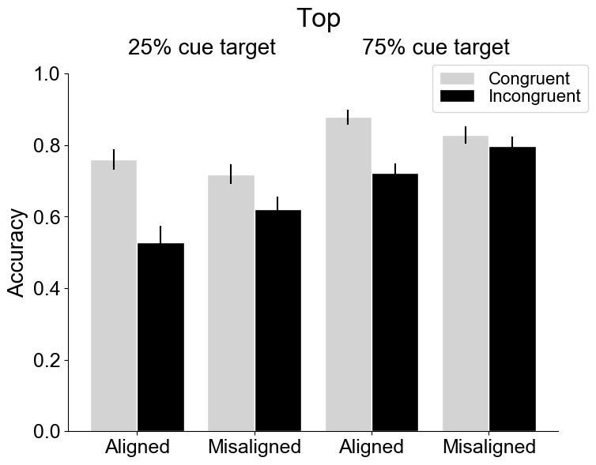
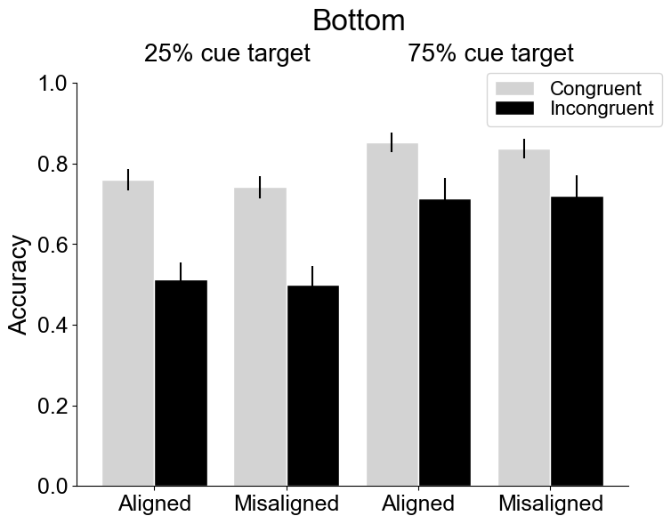
Accuracy: Probability x Cuedhalf x Congruency x Alignment
There were main effects of probability, congruency.
There was a significant three-way interaction between cuedhalf, congruency and alignment, and a significant two-way interaction between congruency and alignment. The four-way interaction and the other interactions did not reach significance.
When the top was the target, there was a interaction between congruency and alignment.
When the bottom was the target, the interaction between congruency and alignment was not significant (no composite effect).
Notes:
25% cue target: there was 25% of chances that the targeted part was cued
75% cue target: there was 75% of chances that the targeted part was cued
Cued half (bottom, top) was mixed within a block, Probability was blocked
All variables were within-subject variables.

Slide 2
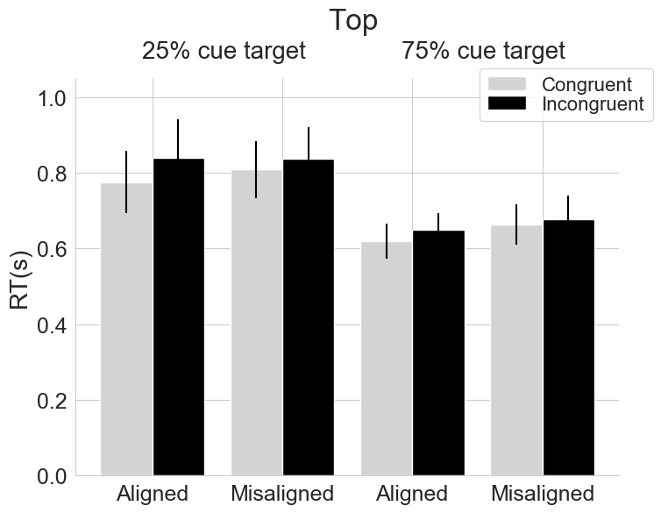
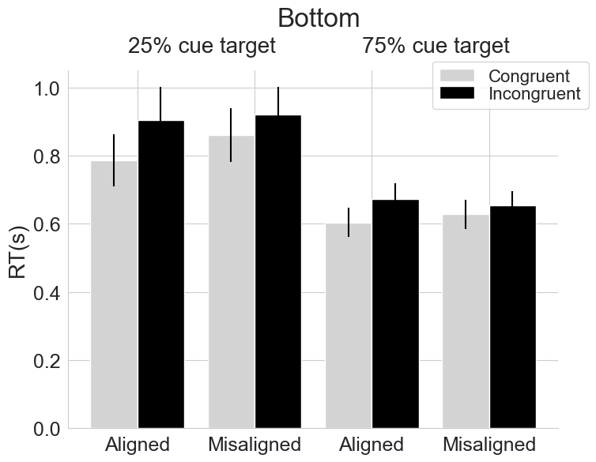
Correct RT: Probability x Cuedhalf x Congruency x Alignment
There were main effects of probability, congruency.
There was a significant two-way interaction between congruency and alignment. The three-way interaction between cuedhalf, congruency and alignement and the other interactions did not reach significance.

Slide 3
d prime: Probability x Cuedhalf x Congruency x Alignment
There were main effects of probability, congruency.
There was a significant three-way interaction between between cuedhalf, congruency and alignment, and a significant two-way interaction between congruency and alignment. The four-way interaction and the other interactions did not reach significance.
When there were 25% chances that the to-be-compared part was cued, d prime for the bottom part in the incongruent conditions, and that for the top part in the aligned-incongruent condition was not significant different from zero.

Slide 4
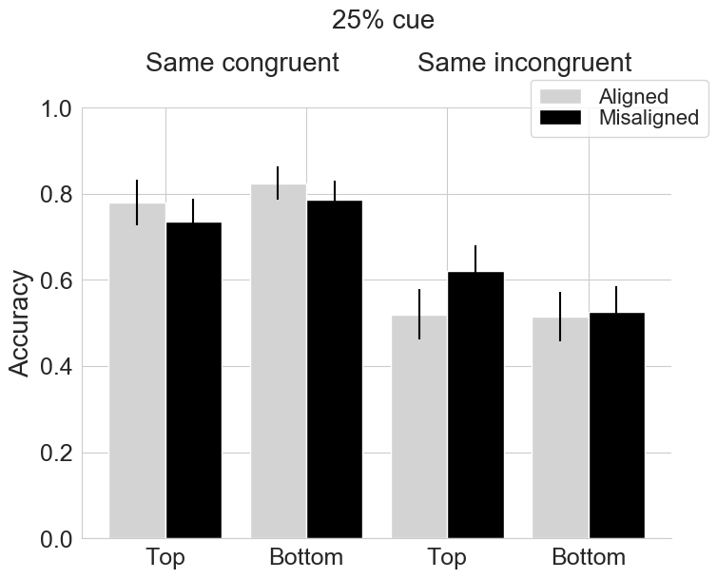
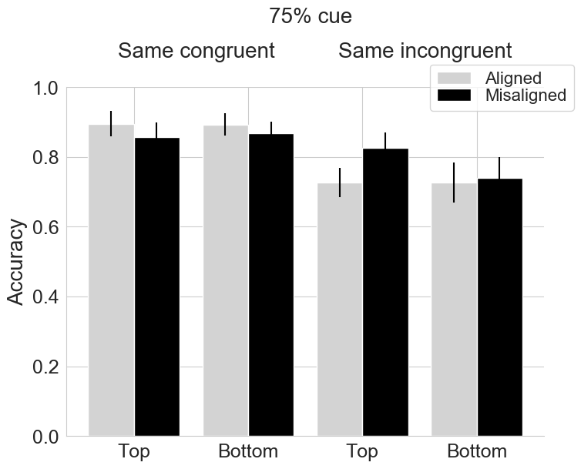
Accuracy : Probability x Cuedhalf x Alignment in the same congruent and same incongruent conditions, separately
Same congruent: main effect of probability (F(1,19) = 12.59, p=.002, ges=.06), main effect of alignment (F(1,19) = 3.45, p=.08, ges=.01), no interactions
Same incongruent: main effect of probability (F(1,19) = 21.72, p=.0002, ges=.16), main effect of alignment (F(1,19) = 8.51, p=.009, ges=.01), interaction between cued half and alignment (F(1,19) = 14.95, p=.001, ges=.008), no other interactions.
Notes:
No difference between aligned and misaligned in the same incongruent condition for the bottom halves, regardless of the cue probability.

Slide 5
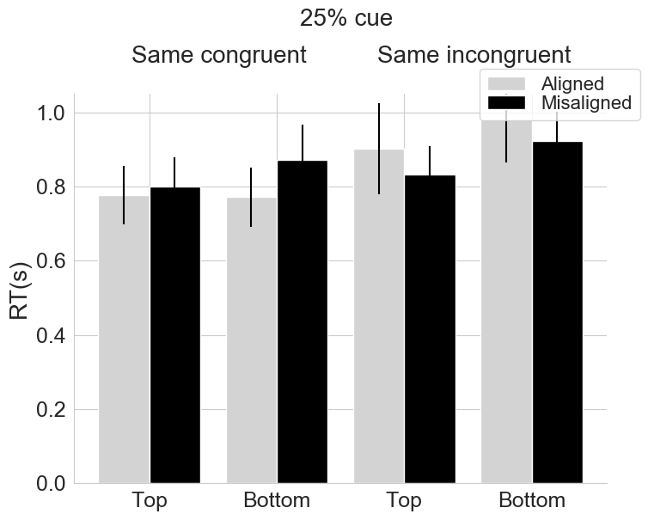
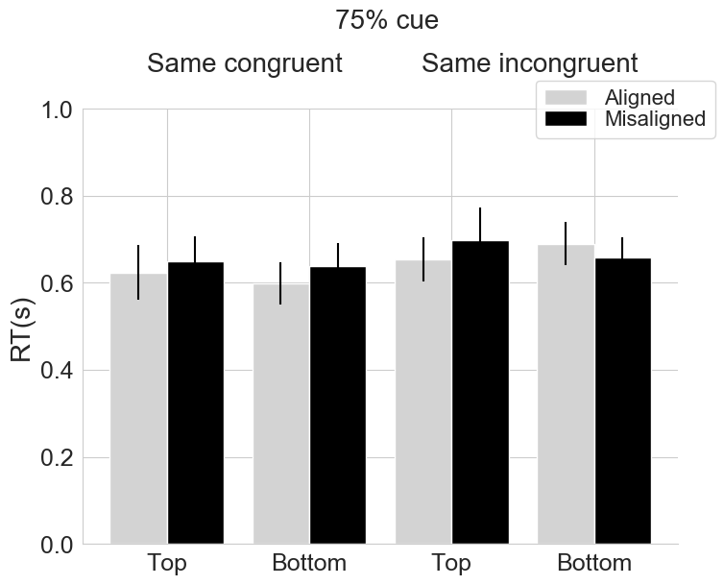
Correct RT : Probability x Cuedhalf x Alignment in the same congruent and same incongruent conditions, separately
Same congruent: main effect of probability (F(1,19) = 8.11, p=.01, ges=.08), main effect of alignment (F(1,19) = 8.40, p=.009, ges=.006), no interactions9
Same incongruent: main effect of probability (F(1,18) = 11.31, p=.003, ges=.08). The main effect of alignment (F(1,18) <1, p=.39, ges=.003) was not significant, nor did any interactions.
Notes:
Same incongruent:
One participant had zero correct responses in the incongruent aligned condition for the top part when the cue was 25% valid.

